Slide 1
Recruitment Management
Genweb2 Ltd.

Slide 2
Content
Create a department
Create a degree
Create a stage
Create a question
Create a label
Create a page
Create a Job Position
Job Positions Dashboard
Email and website Applications
Follow-up
Recruitment tests
Interviews

Slide 3
How to create a department

Slide 4
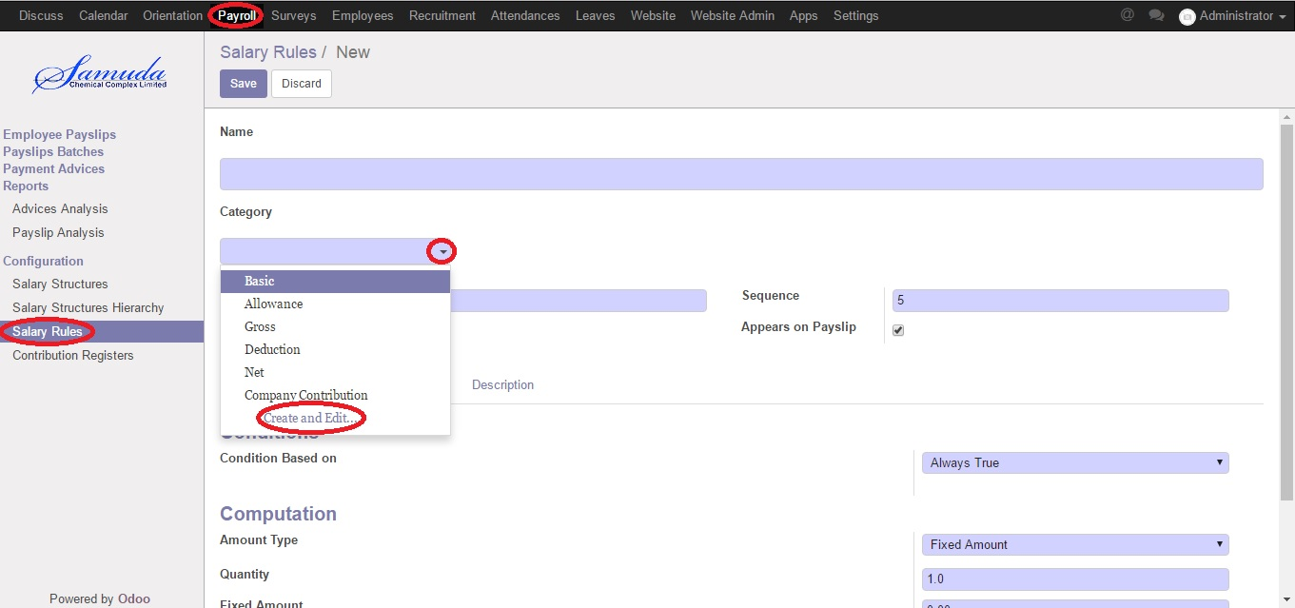
Create a department
Recruitment >> Departments >> Create

Slide 5
How to create a degree

Slide 6
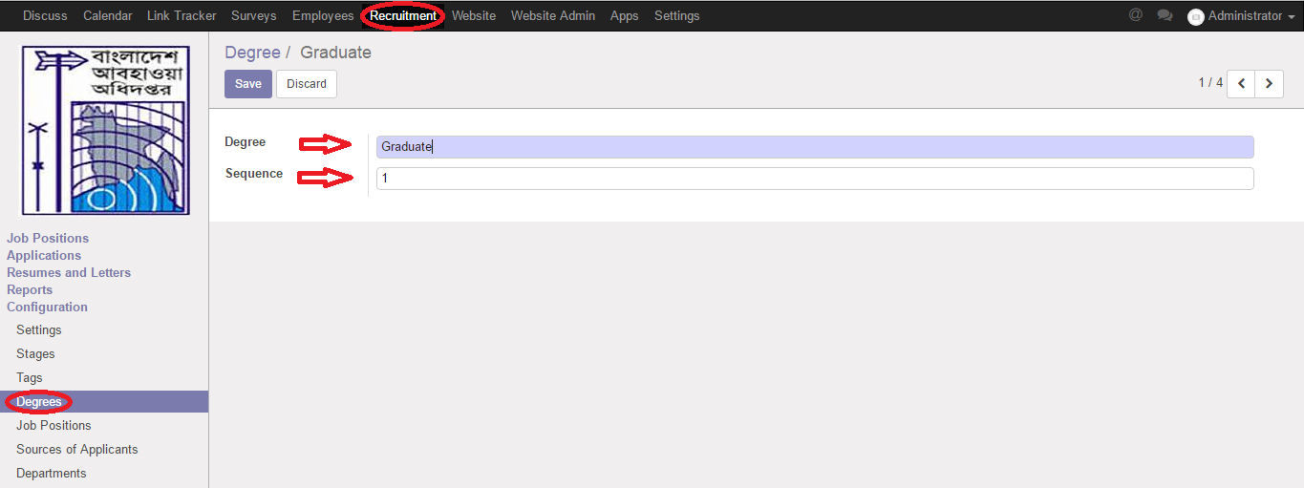
Create a degree
Recruitment >> Degrees >> Create

Slide 7
How to create a stage

Slide 8
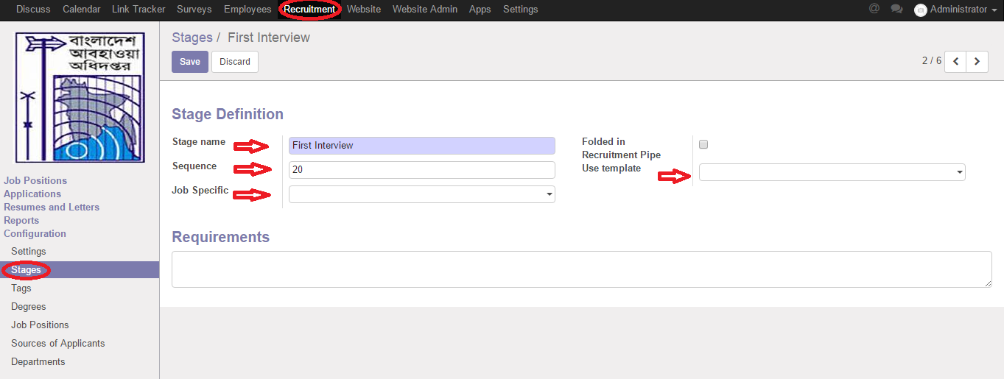
Create a stage
Recruitment >> Stages >> Create

Slide 9
How to create a question

Slide 10
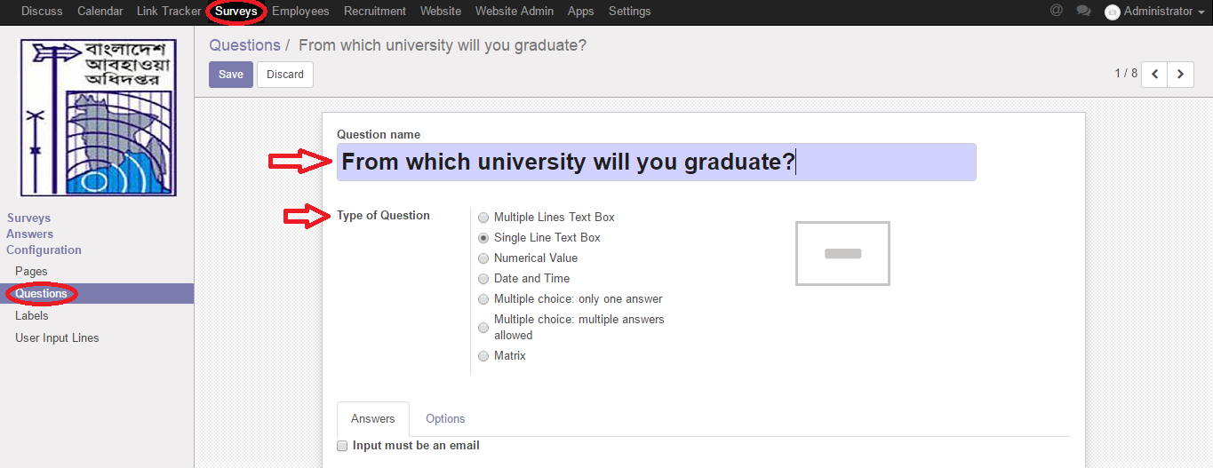
Create a question
Recruitment >> Questions >> Create

Slide 11
How to create a label

Slide 12
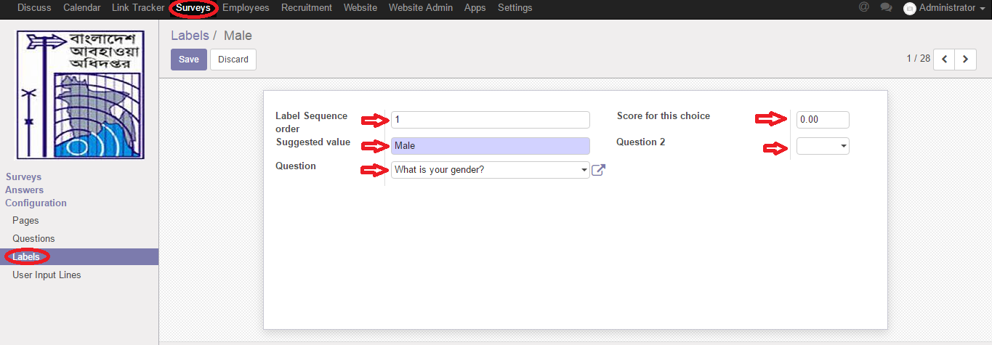
Create a label
Recruitment >> Labels >> Create

Slide 13
How to create a page

Slide 14
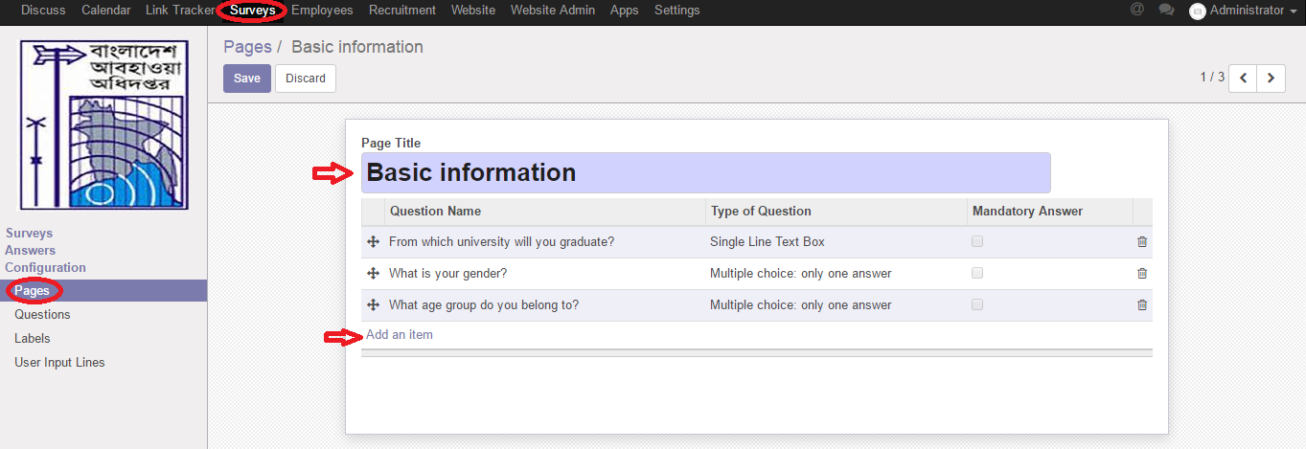
Create a page
Recruitment >> Pages >> Create

Slide 15
How to create a job position

Slide 16
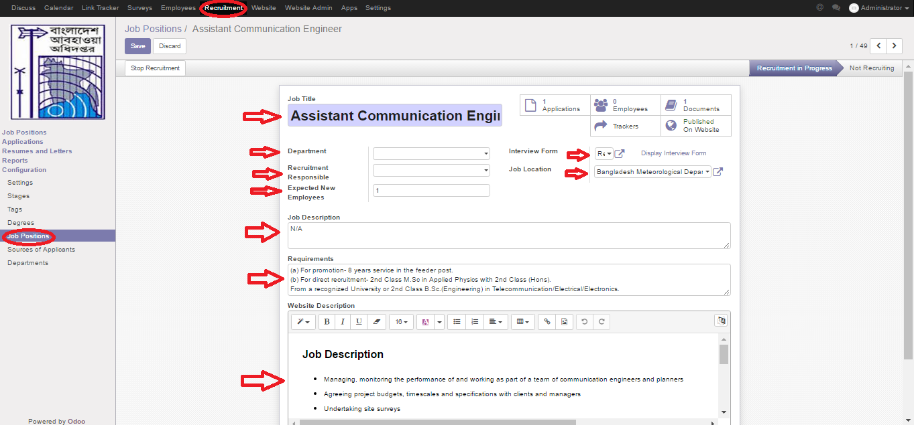
Create a job position
Recruitment >> Job Position >> Create

Slide 17
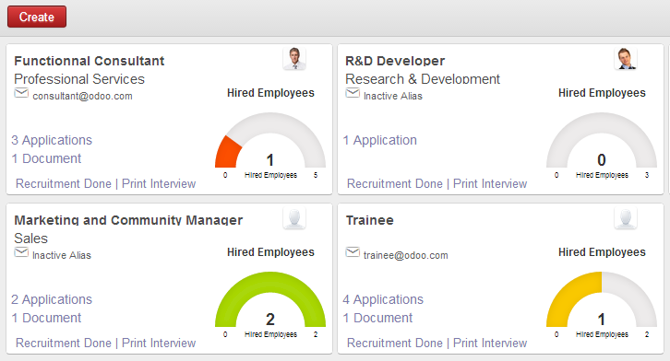
Job positions dashboard
Job positions
Applications
Follow-up
Recruitment tests
Hire or not?

Slide 18
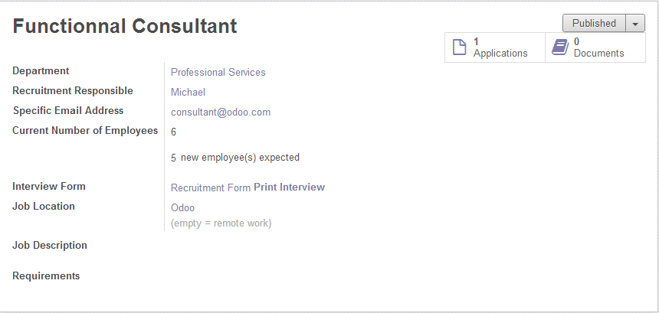
Job positions form view
Job positions
Applications
Follow-up
Recruitment tests
Hire or not?

Slide 19
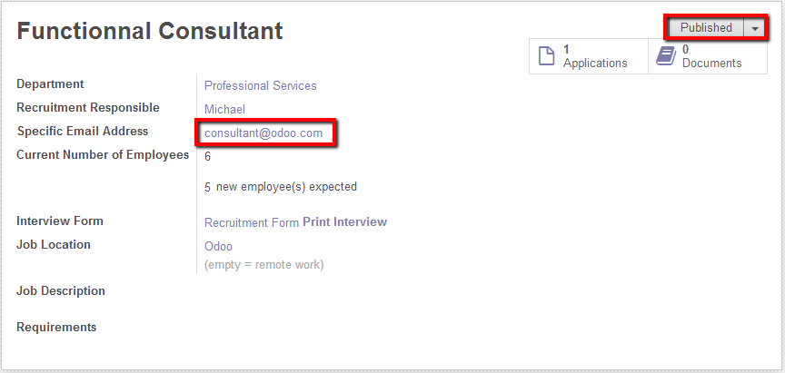
Email and website an application
Job positions
Applications
Follow-up
Recruitment tests
Hire or not?

Slide 20
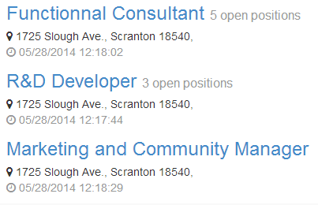
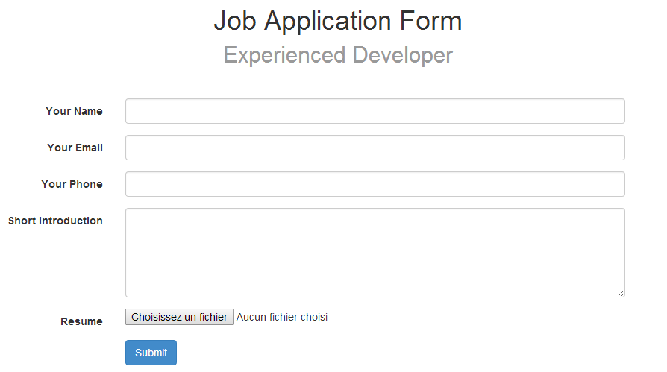
Email and website an application
Job positions
Applications
Follow-up
Recruitment tests
Hire or not?

Slide 21
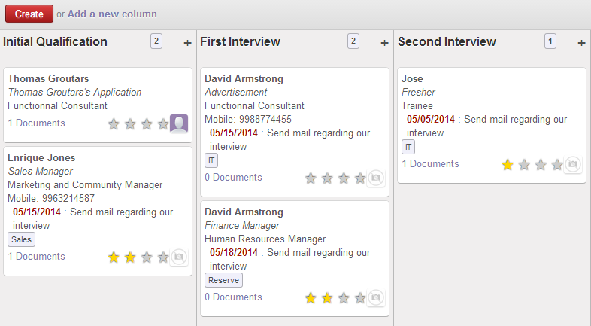
Follow-up
Job positions
Applications
Follow-up
Recruitment tests

Slide 22
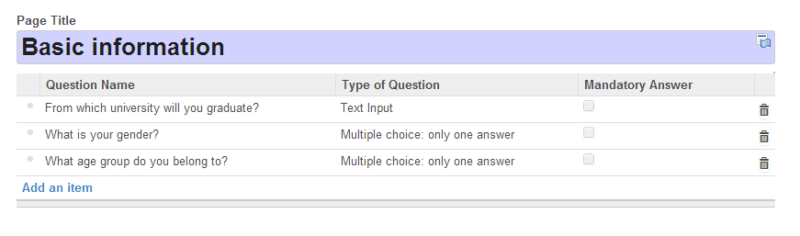
Recruitment tests
Job positions
Applications
Follow-up
Recruitment tests
Hire or not?
Create survey template
In order to test your applicants in function of the job position
applied and which stage of the recruitment process the
Applicant is.

Slide 23
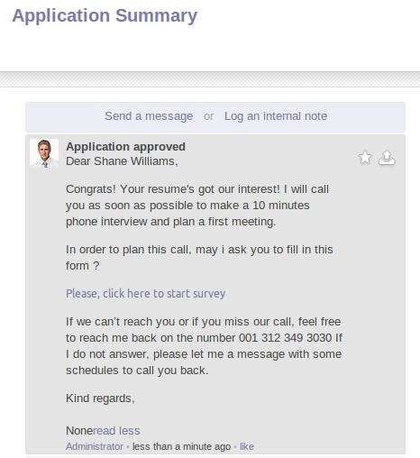
Recruitment tests
Job positions
Applications
Follow-up
Recruitment tests
Hire or not?
Create e-mail template
When candidate apply for
the job, HR send e-mail
with the application test form
or mass-mail all the
applicants in a specific stage.

Slide 24
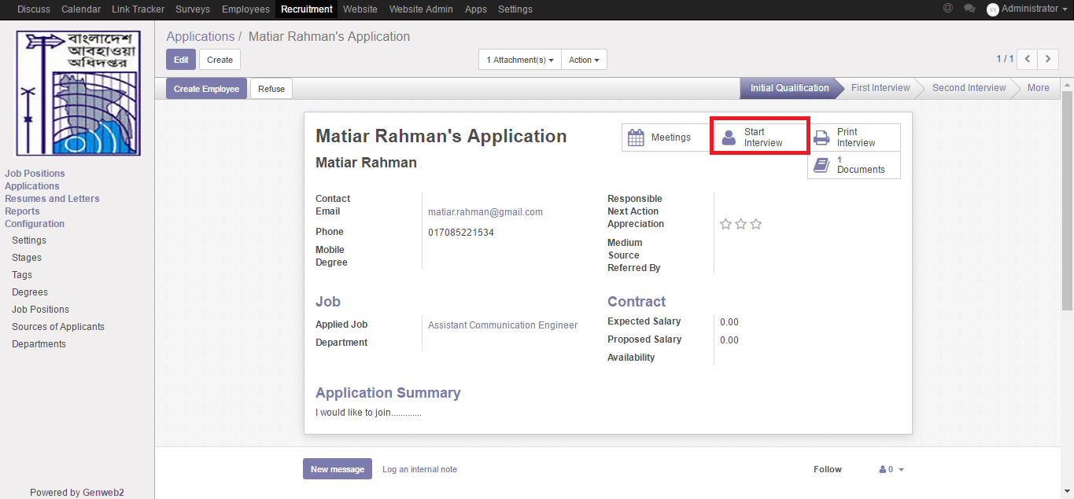
Interviews
Job positions
Applications
Follow-up
Recruitment tests
Start interview

Slide 25
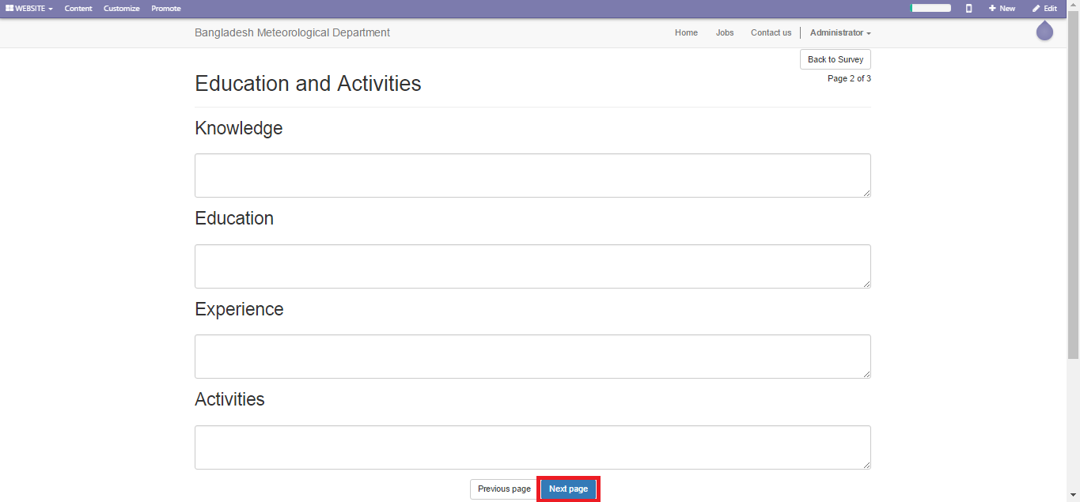
Interviews
Job positions
Applications
Follow-up
Recruitment tests
Start interview

Slide 26
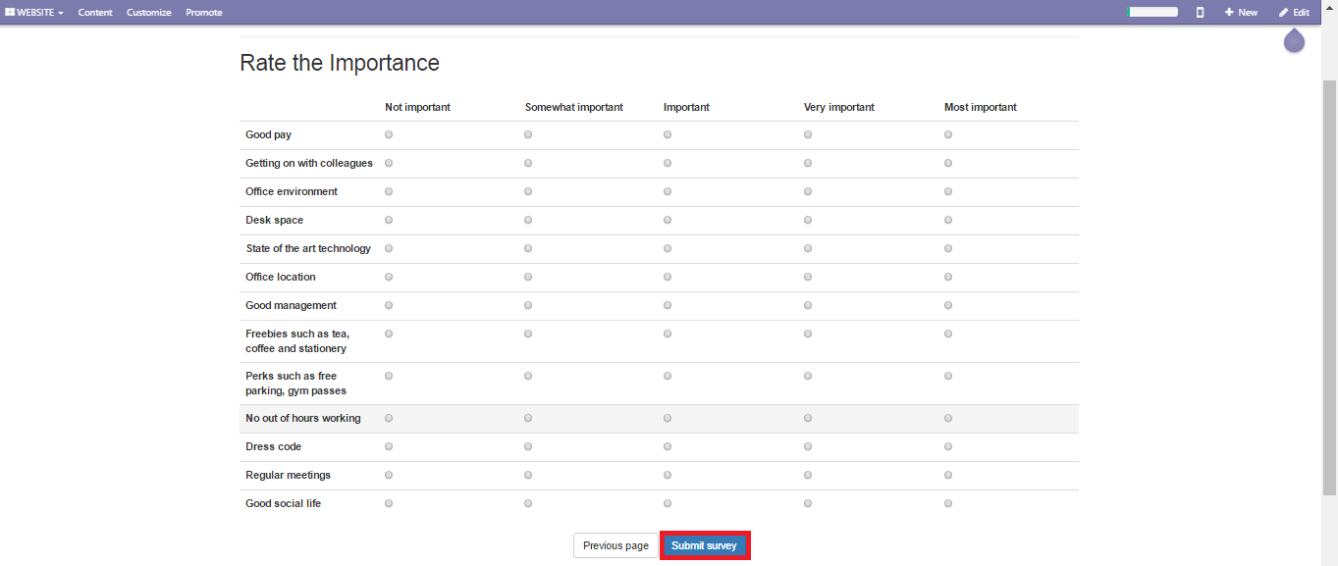
Interviews
Job positions
Applications
Follow-up
Recruitment tests
Start interview

Slide 27
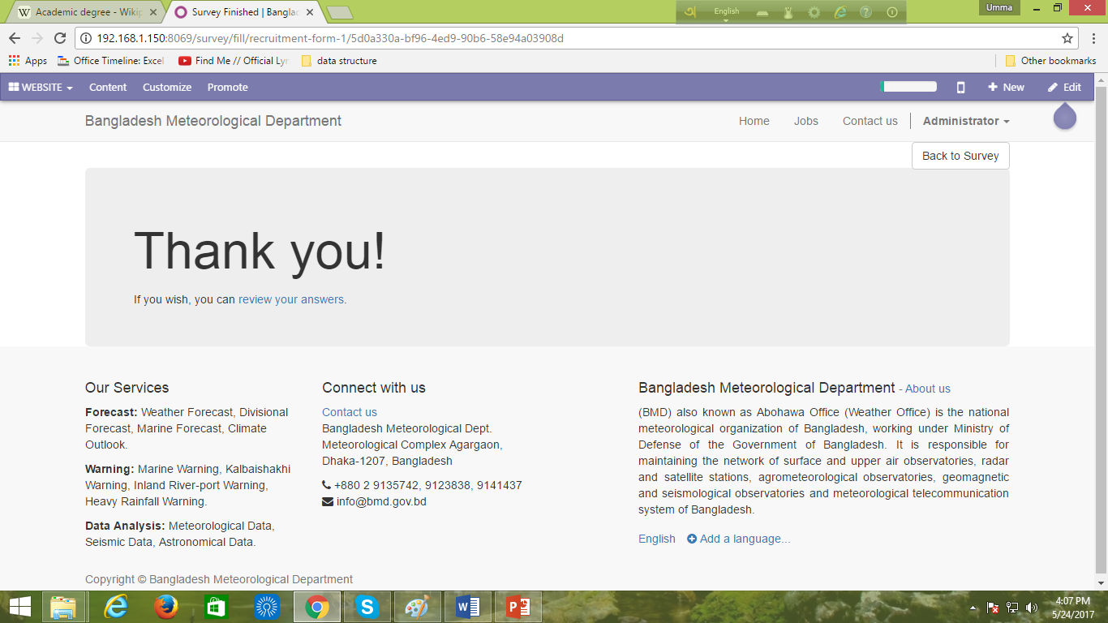
Interviews
Job positions
Applications
Follow-up
Recruitment tests
Start interview

Slide 28
Thank You

